Slide 1
Artificial Neural Networks
Lecture 13
Rabiya Tahir
Senior Lecturer

Slide 2
What are ANNs
An artificial neuron network (neural network) is a computational model that mimics the way nerve cells work in the human brain.

Slide 3
What are ANNs
"...a computing system made up of a number simple, highly interconnected processing
•
of
l h hl d
elements, which process information by their
dynamic state response to external inputs.
M. Caudill 1989
Computational model based on the structure
dynamic state response to external inputs ”
•
and
functions of biological Neural Networks.
© Tariq 2017
2

Slide 4
Brief History of ANN
McCulloch and Pitts (1943) designed the first neural network
Hebb (1949) who developed the first learning rule. If two neurons were active
•
•
at the same time then the strength
tw
them should be increased.
•
Rosenblatt (1958) – introduced the concept of a perceptron which performed
pattern recognition.
Widrow and Hoff (1960) introduced the concept of the ADALINE (ADAptive
•
Linear Element) . The training rule was based on the idea of Least-Mean-
Squares learning rule which minimizing the error between the computed
output and the desired output.
Minsky and Papert (1969) stated that the perceptron was limited in its ability
to recognize features that were separated by linear boundaries. “Neural Net
Winter”
Kohonen and Anderson – independently developed neural networks that acted
like memories.
Webros(1974) – developed the concept of back propagation of an error to train
the weights of the neural network.
McCelland and Rumelhart (1986) published the paper on back propagation
algorithm. “Rebirth of neural networks”.
Today - they are everywhere a decision can be made.
Source : G5AIAI - Introduction to Artificial Intelligence Graham Kendall:
•
•
like memories
•
•
•
© Tariq 2017
Department of Computer Science |
3

Slide 5

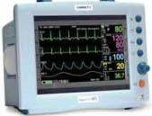
Applications
of ANNs
Intelligent
Advance
Robotics
Control
Technical
Diagnistics
Machine
Vision
Intelligent Data Analysis and Signal Processing
Machine
Vision
Artificial
Intellect with
Neural
Neural
Networks
Image & Pattern
Recognition
Intelligent Expert Systems
Intelligentl
Medicine
Intelligent
Security
Devices
Systems
© Tariq 2017
4

Slide 6
Biological Neural Networks
•
About
10¹¹
neurons in human brain
•
•
About
10^{14~15}
interconnections
Pulse-transmission frequency million
times slower than electronic circuits
Face recognition
•
Face recognition
– hundred million second by human
– Network of artificial neuron
rat
on
speed only a few million second
© Tariq 2017
7

Slide 7

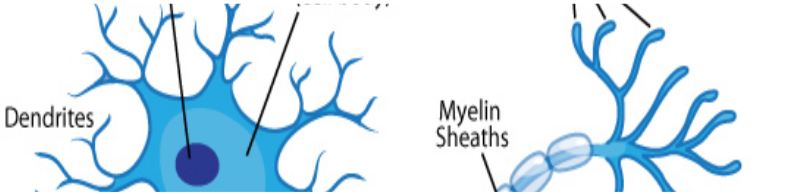
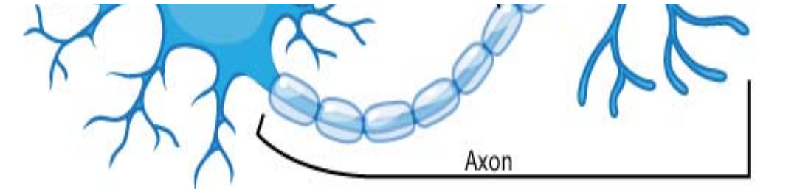
Biological Neuron
•
Cell body: computes a non-
linear function of its inputs
•
Dendrites:
nerve fibres
carrying
electrical
signals to the
cell
•
Axon: single long
fibre that carries
the electrical signal
from the cell body
to other neurons
f h ll b d
•
Synapse: the point of contact between the
axon of one cell and the dendrite of
another, regulating a chemical connection
whose strength affects the input to the cell.
© Tariq 2017
8

Slide 8
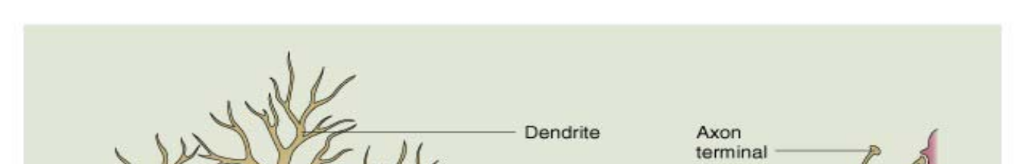

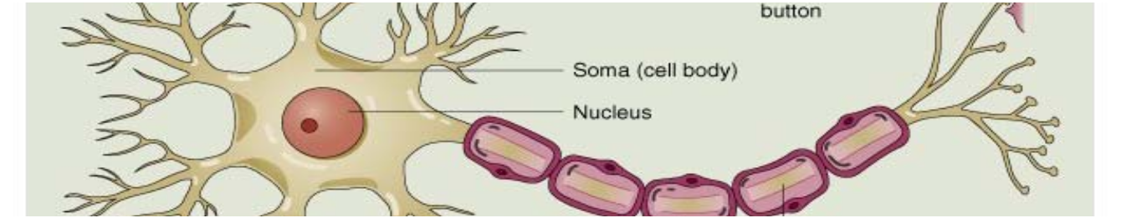
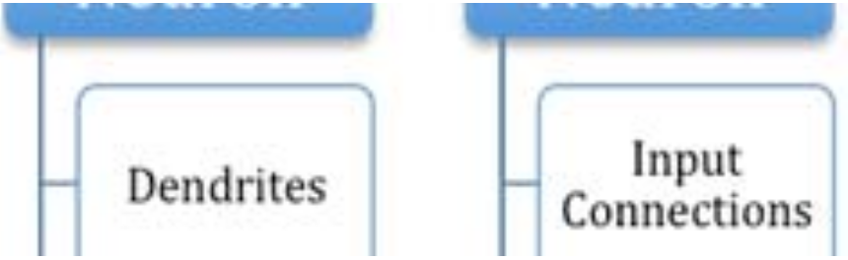

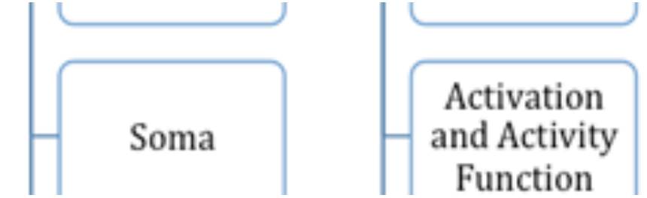
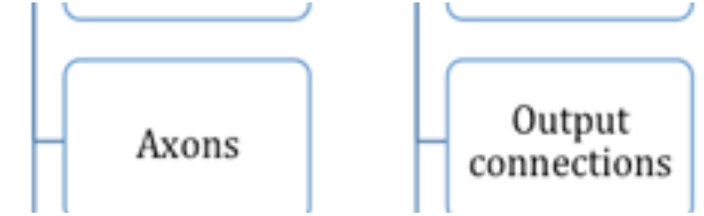
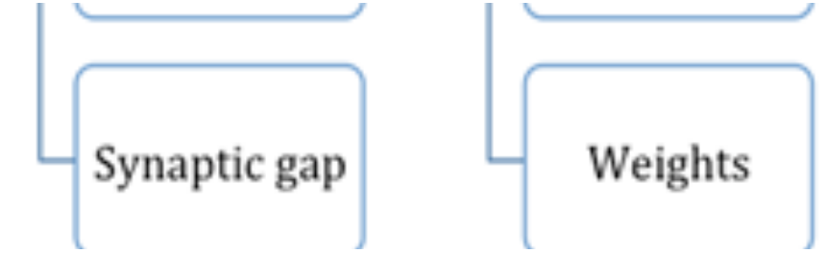
Artificial
Neuron
Model
Inputs
Weights
w₁
p₁
p
w₂
f
a
f
2
w₃
Output
p₃
1
Bias
a =
f (p₁w₁ +
^{p2 w2 + p3 w3 + b)= f (}∑ ^{pi wi + b)}
Department of Computer Science |
10

Slide 9
The McCullogh-Pitts model
Neurons work by processing information. They receive and provide information in form of spikes.
x₁
x₂
x₃
…
x_{n-1}
x_{n}
w₁
w₂
Output
Inputs
y
w₃
.
.
.
w_{n-1}
w_{n}

Slide 10
The McCullogh-Pitts model
The McCullogh-Pitts model:
spikes are interpreted as spike rates;
synaptic strength are translated as synaptic weights;
excitation means positive product between the incoming spike rate and the corresponding synaptic weight;
inhibition means negative product between the incoming spike rate and the corresponding synaptic weight;

Slide 11
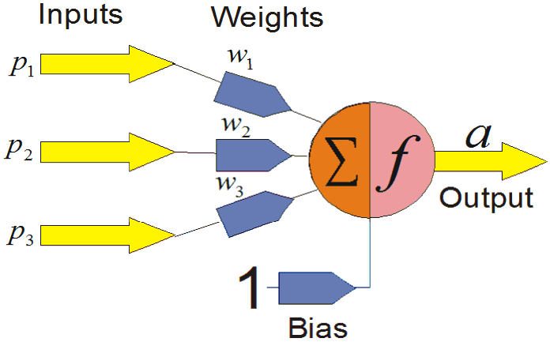
COMPONENTS OF ANNS
Inputs
•
Each input corresponds to a single attribute.
E h d ib
•
Several types of data, such as text, pictures, and voice,
can be used as inputs.
Preprocessing may be needed to convert the raw data
to meaningful inputs from symbolic data.
•
•
The inputs are multiplied by weights
the processing elements (PEs).
when
they
enter
11

Slide 12
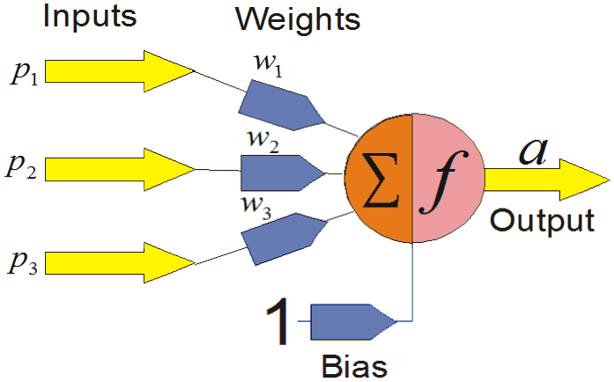
COMPONENTS OF ANNS
Weights
•
Key elements in an ANN are the weights.
K l t i ANN th i ht
•
Weights express the relative strength (or
mathematical value) of the input data or the many
connections that transfer data from layer to layer.
Weights are crucial in that they store learned patterns
of information. It is through repeated adjustments of
weights that the network learns.
•
Department of Computer Science |
12

Slide 13
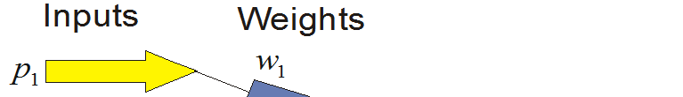
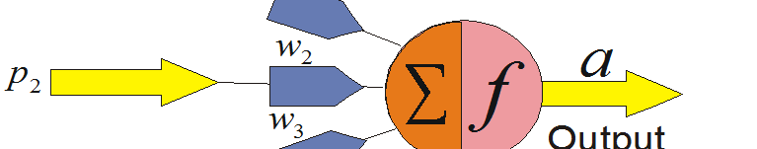
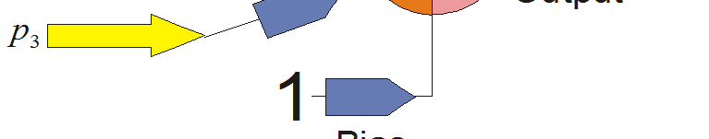
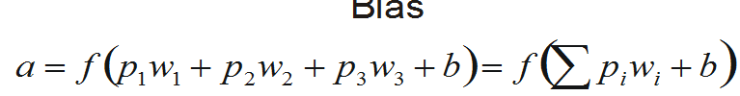
COMPONENTS OF ANNS
Summation function (Ʃ). calculates the weighted
sum of all the input elements
entering
each
processing
element.
Department of Computer Science |
13

Slide 14
COMPONENTS OF ANNS
Transformation (Activation) function(f) integrates
the information produced by all PEs,
and
transforms
it
to
meaningful
outputs.
Department of Computer Science |
14

Slide 15

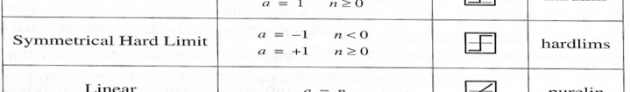
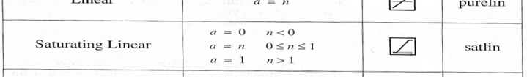
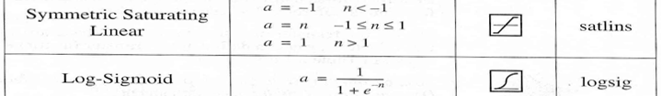
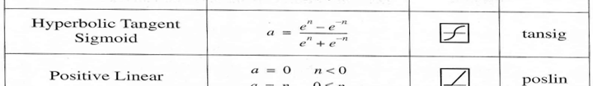

Activation
Functions
Most
commonly
used
15

Slide 16
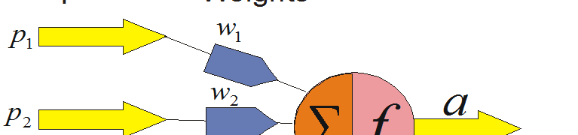
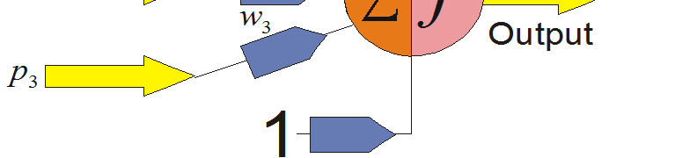
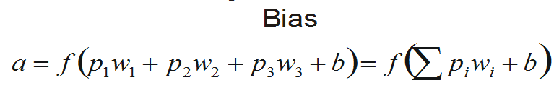
COMPONENTS
Outputs. The outputs of the
OF ANNS
network contain the
solution to a problem. For
example, in the case
of a loan application it can be “yes” or “no.”
The ANN assigns numeric
values,
like
1
for
“yes”
and
0
for
“no.”
16

Slide 17
COMPONENTS OF ANNS
Bias. Bias is an external parameter of the neuron
(typically 1 or -1). A bias value allows you to shift the
activation
function to the left or right, which may be
critical
for
successful
learning.
Here
‘b’
denotes
bias.
i i l f f l l i ‘b’ d bi
Department of Computer
17

Slide 18
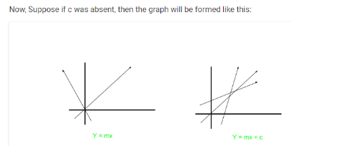
Why Need Bias
For example, consider an equation y=mx+c
Here m is acting as weight and the constant c is acting as bias.

Slide 19
Why Need Bias
Due to the absence of bias, the model will train over point passing through origin only, which is not in accordance with a real-world scenario. Also with the introduction of bias, the model will become more flexible.
It helps the model to learn the patterns and it acts like an input node that always produces constant value 1 or other constant. Because of this property, they are not connected to the previous layer.

Slide 20
Effect of Bias on Activation Function
For Example: Suppose an activation function act() which get triggered on some input greater than 0. Now,
Input1 =1 weight1 =2 input2 =2 weight2 =2
so
output = input1*weight1 + input2*weight2output = 6
Let suppose act(output) = 1
Now a bias is introduced in output as
bias = -6
the output become 0.
act(0) = 0
so activation function will not trigger.

Slide 21
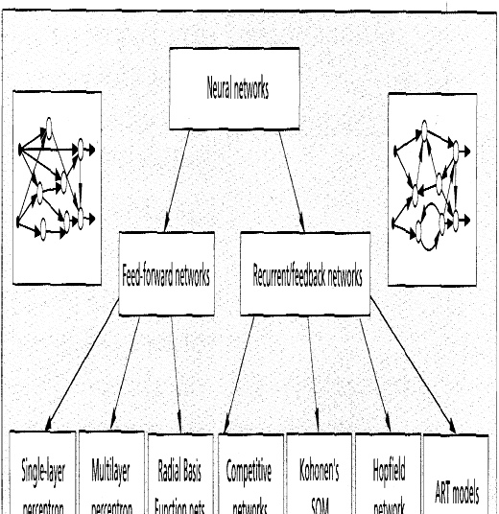
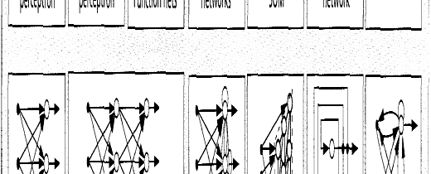
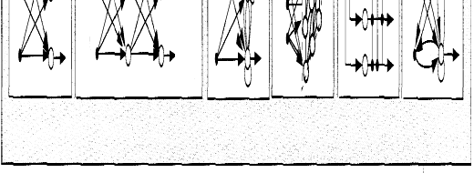
Network
architectures
A taxonomy of feed-forward and recurrent/feedback network architectures.
Department of Computer S
18

Slide 22
Network Architecture
The Architecture of a neural network is linked with the learning algorithm used to train.
•
l l h d
•
There are different classes of network
architecture:
Single-Layer Neural Networks.
o
Si l
o
Multi-Layer Neural Networks.
o The number of layers and neurons
specific task.
depend
on
the
Department of Computer Science |
19

Slide 23
Different
Non-Linearly
Separable
Problems
Structure
Exclusive-OR
problem
Classes with
meshed regions
Most general
Exclusive Classes with general
region shapes
Single-Layer
A B
B A
B
A
Two-Layer
A B
B A
B
A
Three-Layer
A B
B A
B
A
Department of Computer S
20

Slide 24
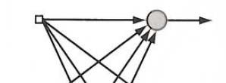
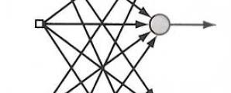
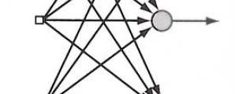
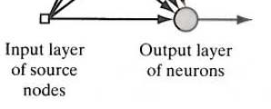
Single Layer Neural
Single-layer feedforward network is
Network
•
Information
Flow
the
simplest form
of
a
layered
network.
There are two layers:
•
l
–
–
Input Layer
Output Layer (Computation Nodes)
•
It
is
feedforward,
means
the
to
information
flow from input
output and not vice versa.
output not versa
•
Input layer of source nodes are
not
counted because
no
computation
is
performed.
Figure 2.1 Feedforwad network
with a single layer of neurons.
21

Slide 25


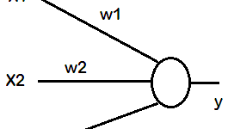



Example
of
Single
Layer
NN
22

Slide 26
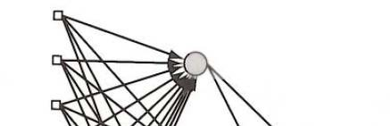
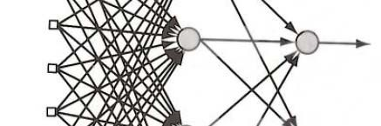
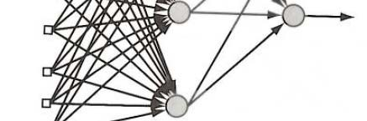
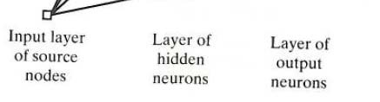
Multilayer Neural
Multilayer feedforward networks has one or more hidden layers.
Multilayer NN overcome the limitation of
Network
Information
Flow
•
•
Single-Layer
NN, they
can
handle
non-
linearly separable learning tasks.
•
By adding hidden layers, the network is
enabled to extract higher-order statistics
from its input.
In this structure, the computation nodes are called hidden neurons or hidden units. The example architecture in Figure 2.2 is
referred to as a 10-4-2 network:
•
•
referred as 10 2 :
–
–
–
10 source nodes
4 hidden neurons
2 output neurons
•
Fully Connected VS Partially Connected
Figure 2.2 Fully connected feedforward
network with one hidden layer and one output layer.
23

Slide 27



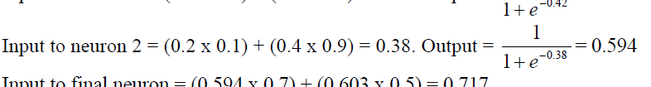
Example of multilayer ANN
Calculate the output from this network assuming a Sigmoid Squashing
Function.
•
24

Slide 28
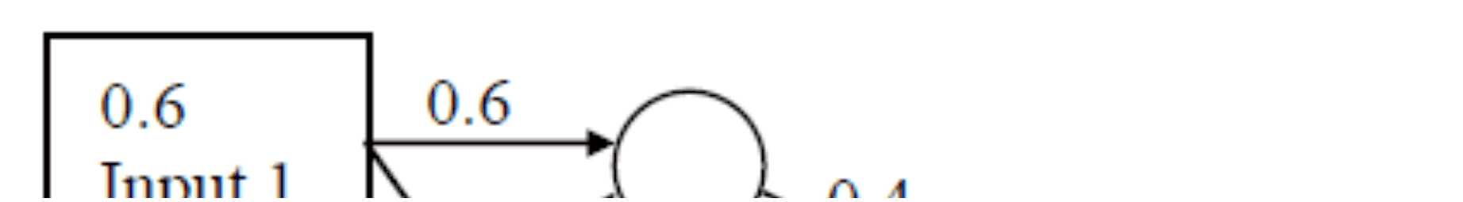
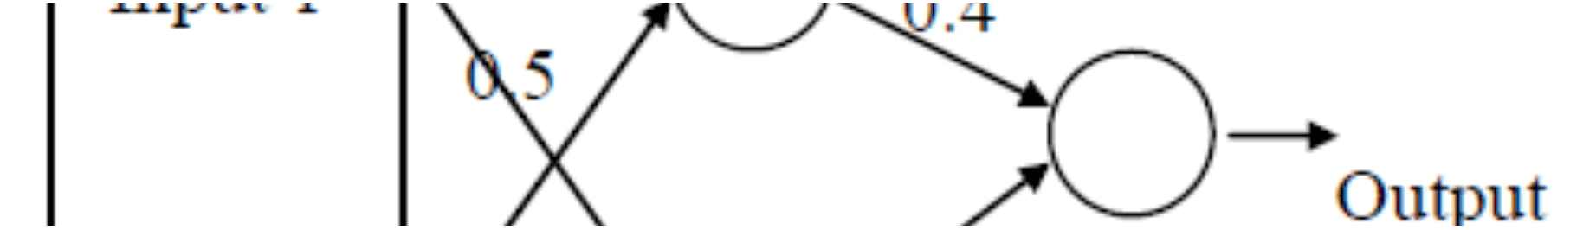
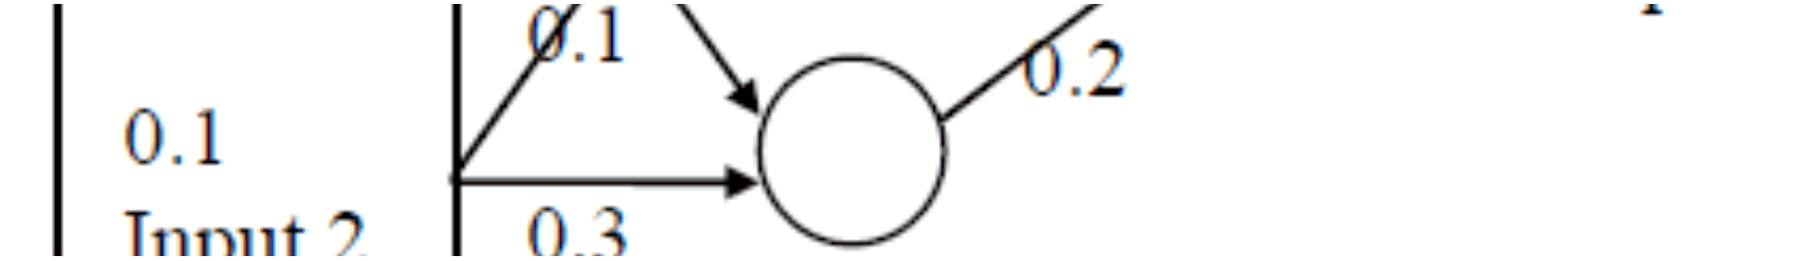
Exercise
of
multilayer
ANN
•
Try calculating the
output of this network yourself.
25

Slide 29
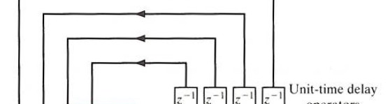
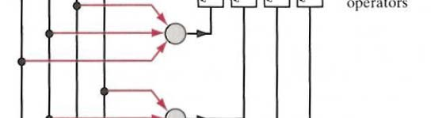
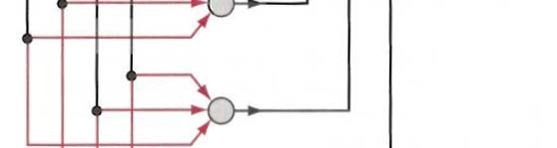

Recurrent
Network
•
Recurrent neural network is
different
from
feedforward
neural
network
feedback
because it has at least one
loop.
•
The presence of feedback loop has a
The of loop a
profound impact
on
the learning
capability
of
the
network
and
its
performance.
The feedback loops particular branches
•
involve the use of
composed of unit-
time delay elements (denoted by
Structure at Figure 2.3:
z⁻¹)
•
–
No
self-feedback loops
in
the
network
No hidden neurons
–
Figure 2.3 Recurrent network with no self-
feedback loops and no hidden neurons.
26

Slide 30
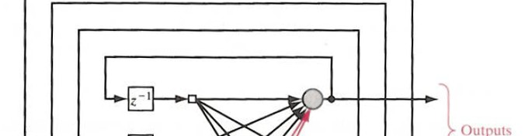
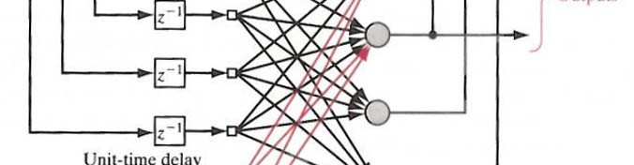

Recurrent
Structure at Figure 2.4:
Network
•
– Contains self-feedback loops in
the network
– Contains hidden neurons
Contains neurons
•
The
feedback
connections
originate
from
the
hidden
neurons as well
output neurons.
as from the
Figure 2.4 Recurrent network with
hidden neurons.
27

Slide 31
Applications of RNN
An RNN can work with sequences such as text, sound, videos, finance data, and more.
Combining CNNs and RNNs helps us work with images and sequences of words in this case. The goal, then, is to generate captions for a given image.

Slide 32



Deep
Learning
More
layers
e hidden layers =
deep learning
Identify Edges
Face Parts
Matching Faces
Input
Match Output
Deep Learning
ML
AI
28

Slide 33
Backpropagation
•
Iteratively process a set of training tuples & compare the network's
prediction with the actual known target value
•
For each training tuple, the weights are modified to minimize the
mean squared error between the network's prediction and the actual
target value
Modifications are made in the “backwards” direction: from the output
•
layer, through each hidden layer down to he first
idden layer, hence
layer through each hidden layer down to the first hidden layer hence
“backpropagation”
Steps
•
–
–
Initialize weights (to small random #s) and biases in the network
Propagate the inputs forward (by applying activation function)
–
–
Backpropagate the error (by updating weights and biases)
Terminating condition (when error is very small, etc.)
29

Slide 34
Back Propagation
Back-propagation is an example of supervised learning is used at each layer to minimize the error between the layer’s response and the actual data
The error at each hidden layer is an average of the evaluated error
Hidden layer networks are trained this way

Slide 35
Training Basics
An ANN can:
compute any computable function, by the appropriate selection of the network topology and weights values.
learn from experience!
Specifically, by trial‐and‐error

Slide 36
Learning by trial‐and‐error
Continuous process of:
Trial:
Processing an input to produce an output (In terms of ANN: Compute the output function of a given input)
Evaluate:
Evaluating this output by comparing the actual output with the expected output.
Adjust:
Adjust the weights.

Slide 37
Backpropagation
Step
by
Step
Example
31

Slide 38
Back Propagation
N is a neuron.
N_{w} is one of N’s inputs weights
N_{out} is N’s output.
N_{w} = N_{w} +Δ N_{w}
Δ N_{o} = N_{out} * (1‐ N_{out})* N_{ErrorFactor} (for output layer neuron)
Δ N_{H} = N_{out} * (1‐ N_{out}) ∑ Δ N₀ *W (for hidden layer neuron)
N_{ErrorFactor} = N_{ExpectedOutput} – N_{ActualOutput}

Slide 39
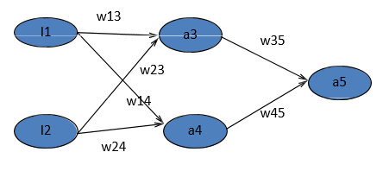
Example
Example: all weights are 0.1 except w45=1; α=1
Training Example: (x1=1,x2=1;a5=1) g is the sigmoid function.
Compute output then adjust the weights and compute output with new weight values.

Slide 40
Example
w13
I1
BP
Example: all weights are 0.1 except w45=1; α=1
Training Example: (x1=1,x2=1;a5=1)
g is the sigmoid function
a3
a3
w35
w23
a5
w14
14
w45
I2
a4
w24
a3=g(z3)=g(x1*w13+x2*w23)=g(1*0.1+1*0.1)=g(0.2)=0.550
a4=g(z4)=g(x1*w14+x2*w24)=g(1*0.1+1*0.1)=g(0.2)=0.550
a5=g(z5)=g(a3*w35+a4*w45)=g(0.550*0.1+0.550*1)=g(0.605)=0.647
32

Slide 41
Example
w13
I1
BP
Example: all weights are 0.1 except w45=1; α=1
Training Example: (x1=1,x2=1;a5=1)
g is the sigmoid function
a3
a3
w35
w23
a5
w14
14
w45
I2
a3=g(z3)=0.550
a4
w24
a4=g(z4)=0.550
a5=g(z5)=0.647
N_{w} = N_{w} +αΔ N_{w}
Δ N_{o} = N_{out} * (1‐ N_{out})* N_{ErrorFactor}
Δ N_{H} = N_{out} * (1‐ N_{out}) ∑ Δ N_{o} *W
N_{ErrorFactor} = N_{ExpectedOutput} – N_{ActualOutput}
Δ5==error*a5*(1-a5)
= 0.353*0.647*0.353=0.08
Δ3=Δ5*w35*a3*(1-a3)=0.002
Δ4=Δ5*w45*a4*(1-a4)=0.02
33

Slide 42
Example
w13
I1
BP
Example: all weights are 0.1 except w45=1; α=1
Training Example: (x1=1,x2=1;a5=1)
g is the sigmoid function
a3
a3
w35
w23
a5
w14
14
w45
I2
a3=g(z3)=0.550
a4
w24
w35= w35 + α*a3*Δ5
=0.1+1*0.55*0.08=0.144
w45= w45 + α*a4*Δ5=1.045
a4=g(z4)=0.550
a5=g(z5)=0.647
Δ5=error*g’(z5)
=error*a5*(1-a5)
= 0.353*0.647*0.353=0.08
w13= w13 + α*x1*Δ3=0.102
w23= w23 + α*x2*Δ3=0.102
w14= w14 + α*x1*Δ4=0.12
14 14 + Δ
Δ3=Δ5*w35*a3*(1-a3)=0.002
Δ4=Δ5*w45*a4*(1-a4)=0.02
w24= w24 + α*x2*Δ4=0.12
34

Slide 43
Example
w13
I1
BP
Example: all weights are 0.1 except w45=1; α=1
Training Example: (x1=1,x2=1;a5=1)
g is the sigmoid function
a3
a3
w35
w23
a5 is 0.6594 with the
adjusted weights!
a5
w14
14
w45
I2
a4
w35= w35 + α*a3*Δ5
=0.1+1*0.55*0.08=0.145
w45= w45 + α*a4*Δ5=1.045
w24
a3=g(z3)=g(x1*w13+x2*w23)
=g(1*0.102+1*0.12)=g(0.222)=0.555
a4=g(z4)=g(x1*w14+x2*w24)
=g(1*0.102+1*0.12)=g(0.222)=0.555
a5=g(z5)=g(a3*w35+a4*w45)
=g(0.555*0.145+0.555*1.045)
=g(0.66045)=0.6594
w13= w13 + α*x1*Δ3=0.102
w23= w23 + α*x2*Δ3=0.102
w14= w14 + α*x1*Δ4=0.12
w24= w24 + α*x2*Δ4=0.12
Hence, current error =(1-0.6594)=0.3406 which is lower than from previous error 0.353
35

Slide 44
ANN Capabilities
&
Limitations
Main capabilities of ANN includes:
•
Learning.
•
•
•
Generalization capability.
Noise filtering.
Parallel processing.
•
•
Distributed knowledge base.
Fault tolerance.
Main problems includes:
•
•
•
Learning sometimes difficult/slow.
Limited storage capability.
Do not do well at tasks that are not done
well
by people
•
•
Lack explanation capabilities
Limitations and expense of hardware technology restrict most applications to software simulations
Training time can be excessive and tedious
•
•
•
Usually requires large amounts of training and test data
50

